Slide 1
Exploratory Testing in the Enterprise
QUEST 2012
April 30 - May 4
Notes:
2:30 PM - 4:00 PM

Slide 2
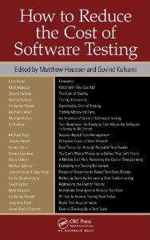
Partner, DeveloperTown | www.DeveloperTown.com
Past President, Association for Software Testing | www.AssociationForSoftwareTesting.org
Articles and Blogs | www.MichaelDKelly.com
Author of the chapter on “Session Based Test Management” in the book How to Reduce the Cost of Software Testing

Slide 3
A STORY
Notes:
SIRO

Slide 4
3 testers instead of 15
66% (or $200,000) cheaper than budgeted
two-week shorter window for testing
delivered on time
no serious defects in production
HOW?

Slide 5
“Simultaneous learning, test design, and test execution.”
- James Bach
Notes:
Mechanics…
What is ET?
What’s someone doing?

Slide 6
pure scripted
fragmentary test cases (scenarios)
freestyle exploratory
vague scripts
charters
roles
-image from Jon Bach
Notes:
approach
alignment with the agile manifesto

Slide 7
the tester, the way they work,
and their ability to work in the future, is
as important as
the product being tested

Slide 8
What makes them “exploratory?”

Slide 9
Self Management
Notes:
Chartering
Refocusing
Branching/Backtracking
Alternating
Recording/Reporting
Resourcing

Slide 10
Developing Ideas
Notes:
Modeling
Questioning
Generating/Elaborating
Overproduction/Abandonment/Recovery
Collaborating

Slide 11
Examining the Product
Notes:
Interacting with the product
Observing
Applying tools
Conjecturing
Modeling

Slide 12
There’s always resistance

Slide 13
A desire for visible,
track-able, progress
Notes:
the illusion of progress
Gantt charts
test case counts and percent completes
mythology of the v-model

Slide 14
It’s difficult to quantitatively
measure coverage
Notes:
traceability and feature coverage
more test case counts and percent completes

Slide 15
There’s extraordinary pressure for
“reuse” and “cost control”
Notes:
outsourcing
automation
training materials
regression testing

Slide 16
Session Based Test Management

Slide 17
charters

Slide 18
charters
time-boxed

Slide 19
charters
time-boxed
session notes

Slide 20
charters
time-boxed
session notes
debriefs

Slide 21
charters
time-boxed
session notes
debriefs
team prioritization

Slide 22
charters
time-boxed
session notes
debriefs
team prioritization
ad-hoc test documentation
Notes:
ad hoc does not mean unstructured

Slide 23
charters
time-boxed
session notes
debriefs
team prioritization
ad-hoc test documentation
ad-hoc test automation
Notes:
ad hoc does not mean unstructured

Slide 24
charters
time-boxed
session notes
debriefs
team prioritization
ad-hoc test documentation
ad-hoc test automation
dynamic metrics and reporting

Slide 25
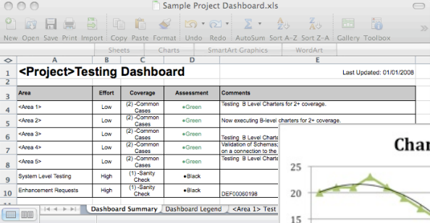
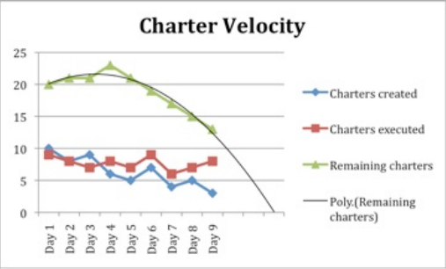
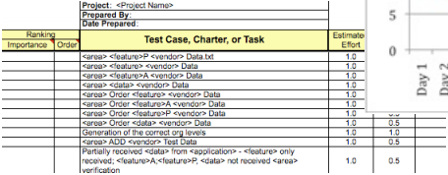
Notes:
real-time visibility and coverage

Slide 26
Focus on dealing with uncertainty

Slide 27
START
Notes:
How do you roll this out?

Slide 28
Begin by implementing a specific practice

Slide 29
Add exploratory testing days to
the end of existing test cycles

Slide 30
Carve out a small portion of an existing project and apply exploratory testing to that portion

Slide 31
Run a pilot project
Notes:
- CTI = slow transition over time
- SIRO = all in

Slide 32
Responding to concerns

Slide 33
the Michael Jordan effect

Slide 34
“We don’t do agile.”
Notes:
Neither do most places I’ve implemented ET.

Slide 35
“What about regression testing?”
Notes:
charter it like anything else
leverage ad hoc documentation
automation

Slide 36
“We hand our test scripts off for test automation…”
Notes:
automate real-time
notes
record Selenium sessions

Slide 37
“How do you provide traceability?”
Notes:
don’t
tools
notes
alternatives means (SEP and unit tests to requirements)

Slide 38
“Your percent complete keeps changing!”
Notes:
illusion of control
better than existing methods
trend lines

Slide 39
“Don’t we lose the ability to add people late in the project if we get sideways?”
Notes:
risk-based approach
if that’s a real concern, provide alternative strategies for certain risks

Slide 40
“Our testers aren’t subject matter experts.”
Notes:
neither am I – I play one on TV
involve the SMEs (targeted documentation, pairing, embed them in the team)
build SMEs

Slide 41
“We can’t afford all senior testers.”
Notes:
elliptical model

Slide 42
“How do you make charters repeatable?”
Notes:
automation
Ad hoc documentation
Excellent notes

Slide 43
“What about estimation?”
Notes:
Estimate in sessions instead of “hours” or “test cases”

Slide 44
Let’s do some testing…

Slide 45
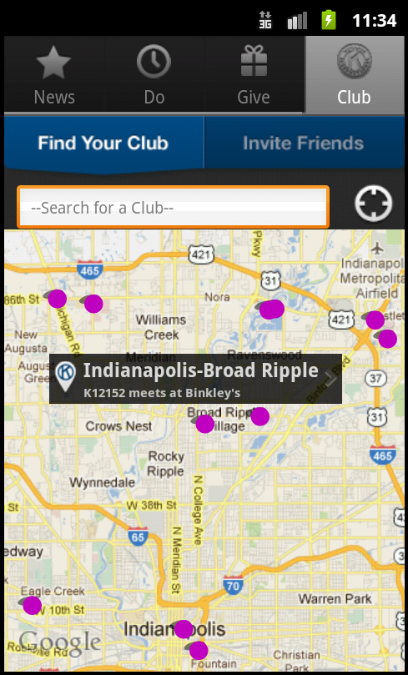
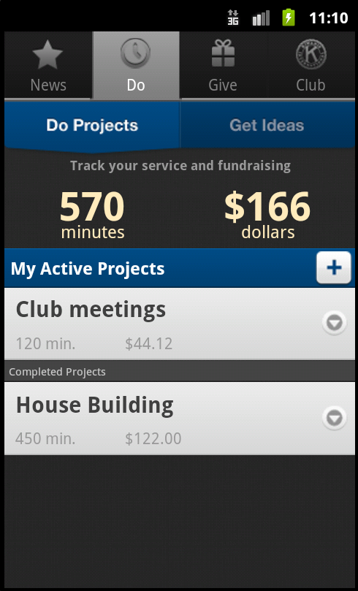
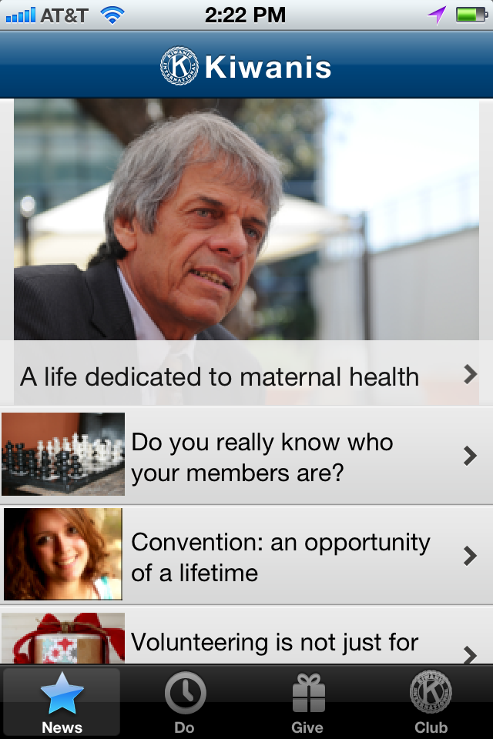

Slide 46
The Process
Find a partner (pair up)
Pick a charter (next slide) or write your own
Test for 20 minutes
one person will drive the app
one person will take notes
Group debrief

Slide 47
Kiwanis International App :: Charters
Test for boundary related issues related to projects
Test for boundary related issues related to project reports
Test for deliverability related issues related to project emails
Test for data quality issues with clubs available on the app
Test for data accuracy issues related to calculations on project reports
Test for data accuracy issues related to calculations on service and fundraising summary stats
Test for data accuracy issues related to Piggy Bank commitment calculations
Perform basic link validation for items in the news feed
Perform a copy review of the various descriptive dialogs in the app looking for typos and grammar issues
Test for performance related issues related to mapping capabilities
Stress test the application to identify conditions that crash the app

Slide 48
Group Debrief
Notes:
Estimate in sessions instead of “hours” or “test cases”

Slide 49
Process Debrief
Identify key coverage areas in the app

Slide 50
Process Debrief
Identify key coverage areas in the app
Identify key risks for each area

Slide 51
Process Debrief
Identify key coverage areas in the app
Identify key risks for each area
Draft charters

Slide 52
Process Debrief
Identify key coverage areas in the app
Identify key risks for each area
Draft charters
As a team, estimate those charters and break them up or combine them as needed

Slide 53
Process Debrief
Identify key coverage areas in the app
Identify key risks for each area
Draft charters
As a team, estimate those charters and break them up or combine them as needed
As a team, prioritize them

Slide 54
Process Debrief
Identify key coverage areas in the app
Identify key risks for each area
Draft charters
As a team, estimate those charters and break them up or combine them as needed
As a team, prioritize them
Pull from the top and test

Slide 55
Process Debrief
Identify key coverage areas in the app
Identify key risks for each area
Draft charters
As a team, estimate those charters and break them up or combine them as needed
As a team, prioritize them
Pull from the top and test
Debrief, create new charters, reprioritize

Slide 56
Questions?

Slide 57
Reading Materials
Bach, James. "Exploratory Testing Explained." First published as a chapter in The Test Practitioner, 2002. Available online at: http://www.satisfice.com/articles/et-article.pdf
Bach, James and Jon Bach. "Exploratory Testing Dynamics." Available online at: http://www.satisfice.com/articles/et-dynamics.pdf
Bach, Jon. "Session Based Test Management." First published in Software Testing and Quality Engineering, November 2000. Available online at: http://www.satisfice.com/articles/sbtm.pdf
Bach, James. "A Low-Tech Testing Dashboard." Presented at STAREast, 1999. Available online at: http://www.satisfice.com/presentations/dashboard.pdf
Bach, Jon. "How to Manage and Measure Exploratory Testing." Quardev, 2006. Available online at: http://www.quardev.com/content/whitepapers/how_measure_exploratory_testing.pdf
Petty, Kenn. "Reflections on the Use of Session-Based Exploratory Testing As the Primary Test Methodology for Software in an Agile Environment." Presented at the Indianapolis Workshops on Software Testing, April 2005. Available online at: http://www.indianapolisworkshops.com/docs/Reflections_on_the_use_of_Session-Based_Exploratory_Testing_in_an_Agile_Environment.doc
Petty, Kenn. "Transitioning from Standard V&V to Rapid Testing Practices in a Chaotic Project Environment." Presented at the Conference of the Association for Software Testing, 2007. Available online at: http://www.associationforsoftwaretesting.org/documents/Kenn_Petty_Transitioning_from_Standard_V&V_to_Rapid_Testing_Practices.pdf
Wood, Bill and David James. "Applying Session-Based Testing to Medical Software." Medical Device and Diagnostic Industry Magazine, May 2003. Available online at: http://www.mddionline.com/article/applying-session-based-testing-medical-software
Kelly, Michael. “The benefits of exploratory testing in agile environments.” SearchSoftwareQuality.com, 2009. Available online at: http://searchsoftwarequality.techtarget.com/tip/0,289483,sid92_gci1350741,00.html
Kelly, Michael. “Using session-based test management for exploratory testing.” SearchSoftwareQuality.com, 2009. Available online at: http://searchsoftwarequality.techtarget.com/tip/0,289483,sid92_gci1352925_mem1,00.html
Kelly, Michael. “Using session-based test management for exploratory testing coverage problems.” SearchSoftwareQuality.com, 2009. Available online at: http://searchsoftwarequality.techtarget.com/tip/0,289483,sid92_gci1355475_mem1,00.html
Kelly, Michael. “Solving problems with session-based test management.” SearchSoftwareQuality.com, 2009. Available online at: http://searchsoftwarequality.techtarget.com/tip/0,289483,sid92_gci1355815_mem1,00.html

